Slide 1

SQL Project On
Music Store Data
Analysis

Slide 2

HELLO
MyꢀnameꢀisꢀVaidehiꢀPatelꢀ
andꢀthisꢀisꢀmyꢀSqlꢀprojectꢀonꢀ
MusicꢀStoreꢀDataꢀAnalysis.
IꢀhaveꢀutilizedꢀSqlꢀqueriesꢀtoꢀ
solveꢀquestionsꢀrelatedꢀtoꢀ
MusicꢀStoreꢀDataꢀTakenꢀ
fromꢀkaggleꢀ.

Slide 3
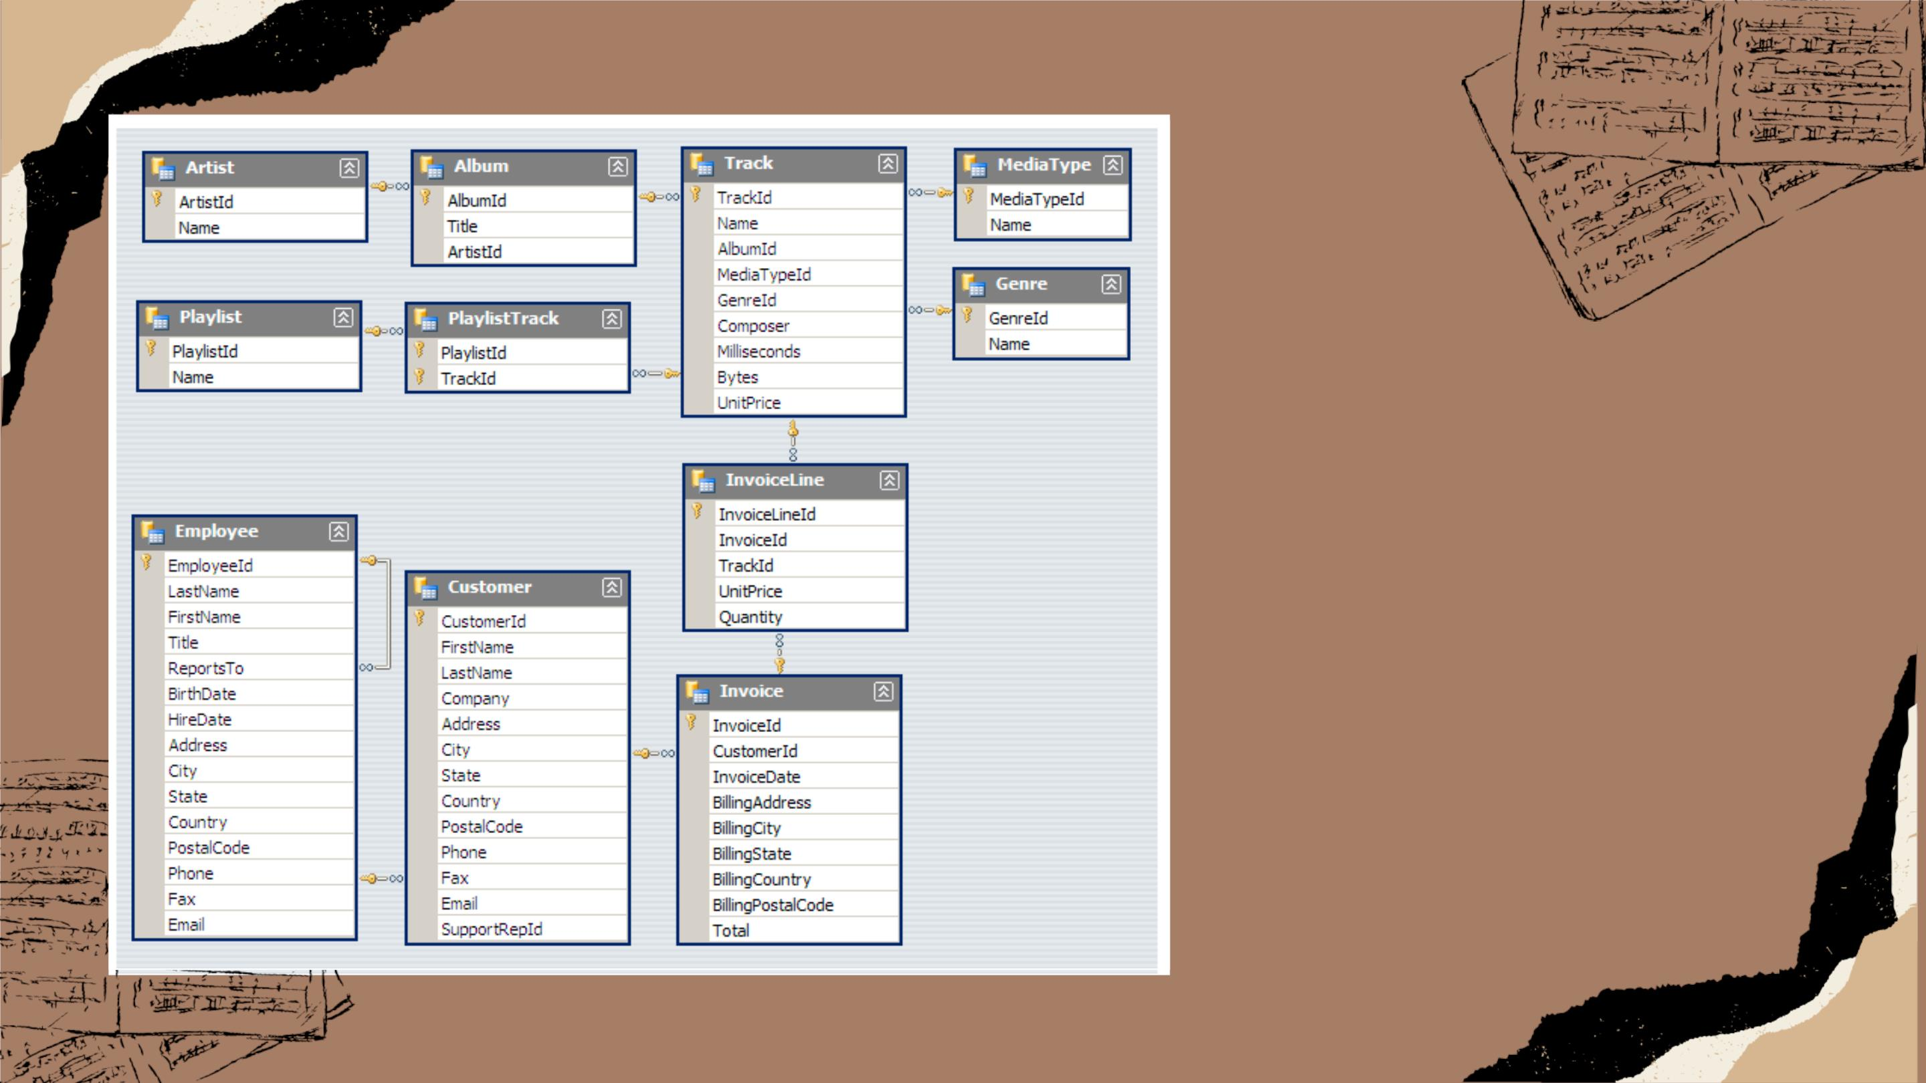
TablesꢀPresentꢀinꢀMusicꢀ
StoreꢀDataꢀAnalysis
Databaseꢀꢀ

Slide 4

BASIC

Slide 5
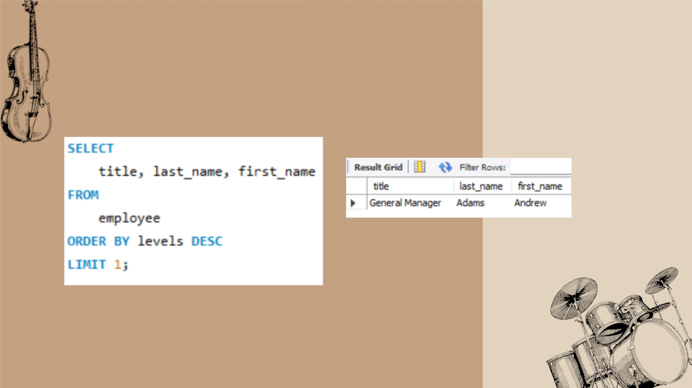
• Whoꢀ isꢀ theꢀ seniorꢀ mostꢀ employeeꢀ basedꢀ onꢀ jobꢀ
title?
SQLꢀQUERY:
RESULT:

Slide 6
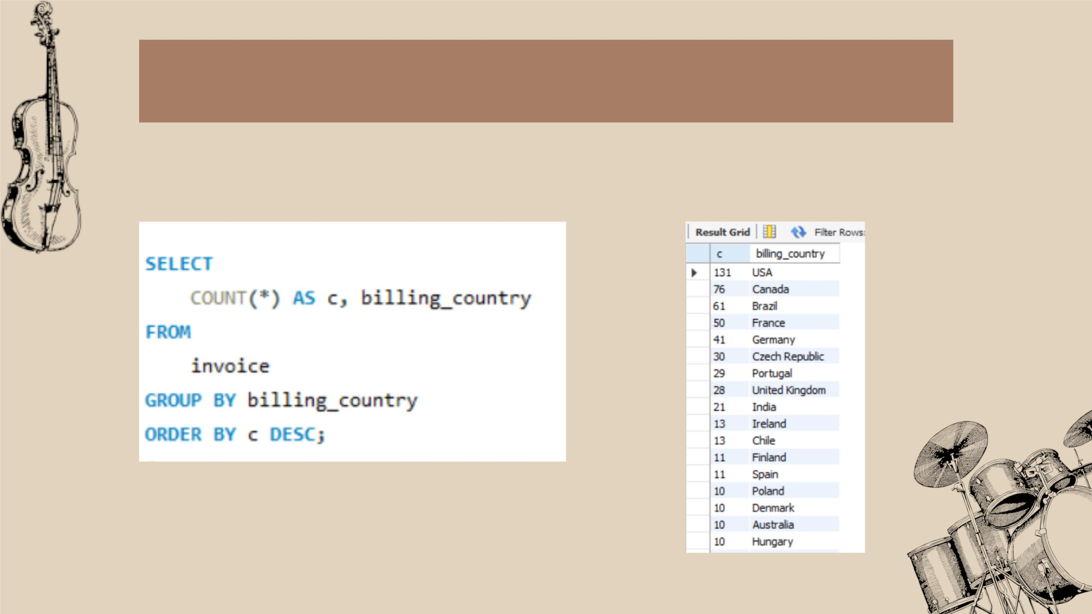
• WhichꢀcountriesꢀhaveꢀtheꢀmostꢀInvoices?
SQLꢀQUERY:
RESULT:

Slide 7
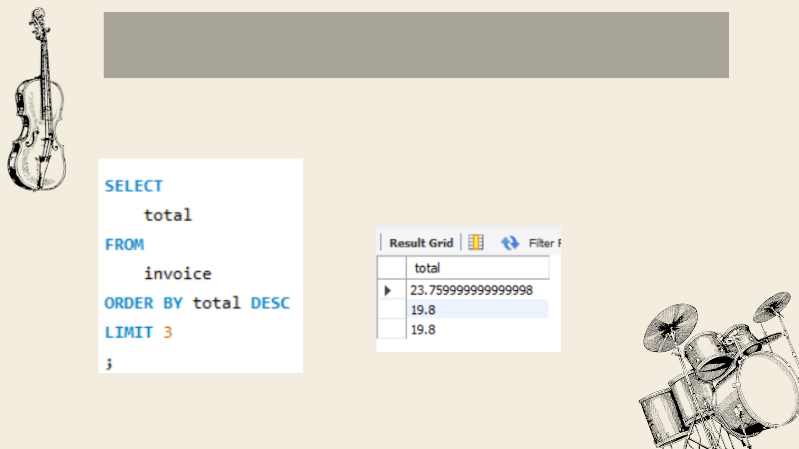
• Whatꢀareꢀtopꢀ3ꢀvaluesꢀofꢀtotalꢀinvoice?
SQLꢀQUERY:
RESULT:

Slide 8
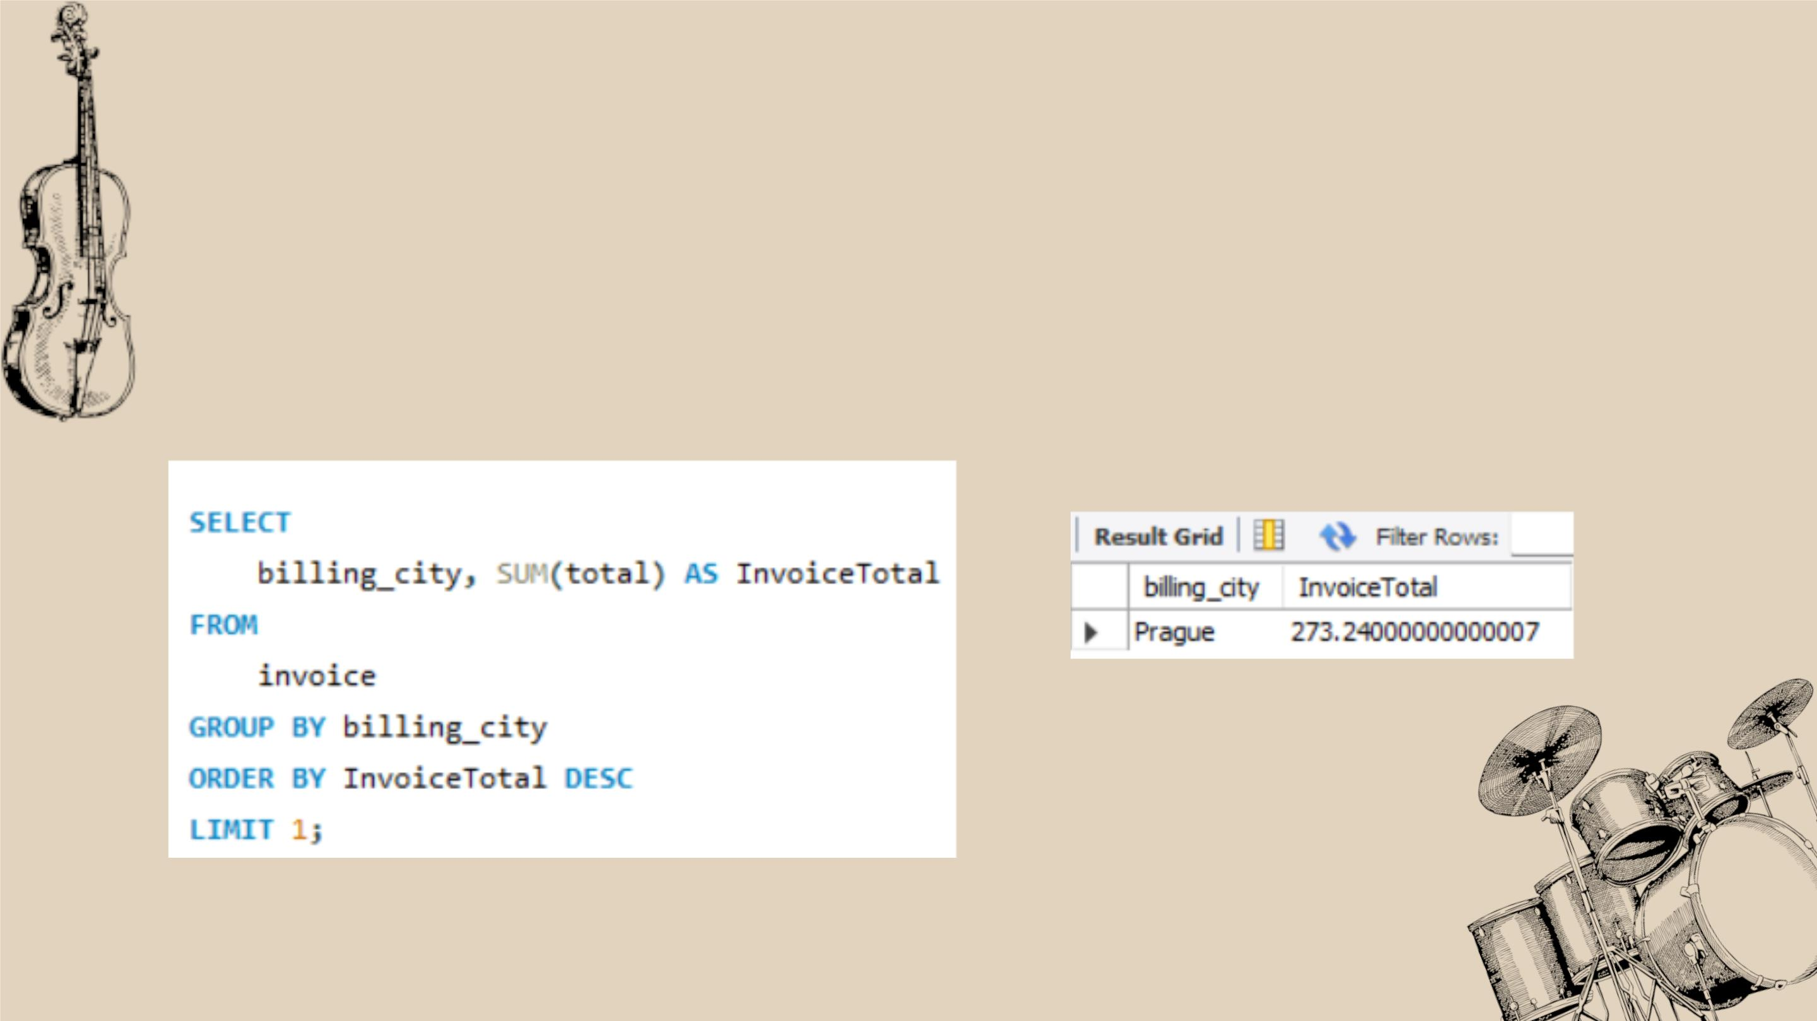
• Q4:ꢀ Whichꢀ cityꢀ hasꢀ theꢀ bestꢀ customers?ꢀ Weꢀ wouldꢀ likeꢀ toꢀ throwꢀ aꢀ promotionalꢀ
MusicꢀFestivalꢀinꢀtheꢀcityꢀweꢀmadeꢀtheꢀmostꢀmoney.ꢀWriteꢀaꢀqueryꢀthatꢀreturnsꢀ
oneꢀ cityꢀ thatꢀ hasꢀ theꢀ highestꢀ sumꢀ ofꢀ invoiceꢀtotals.ꢀ Returnꢀ bothꢀ theꢀ cityꢀ nameꢀ
&ꢀsumꢀofꢀallꢀinvoiceꢀtotals
SQLꢀQUERY:
RESULT:

Slide 9
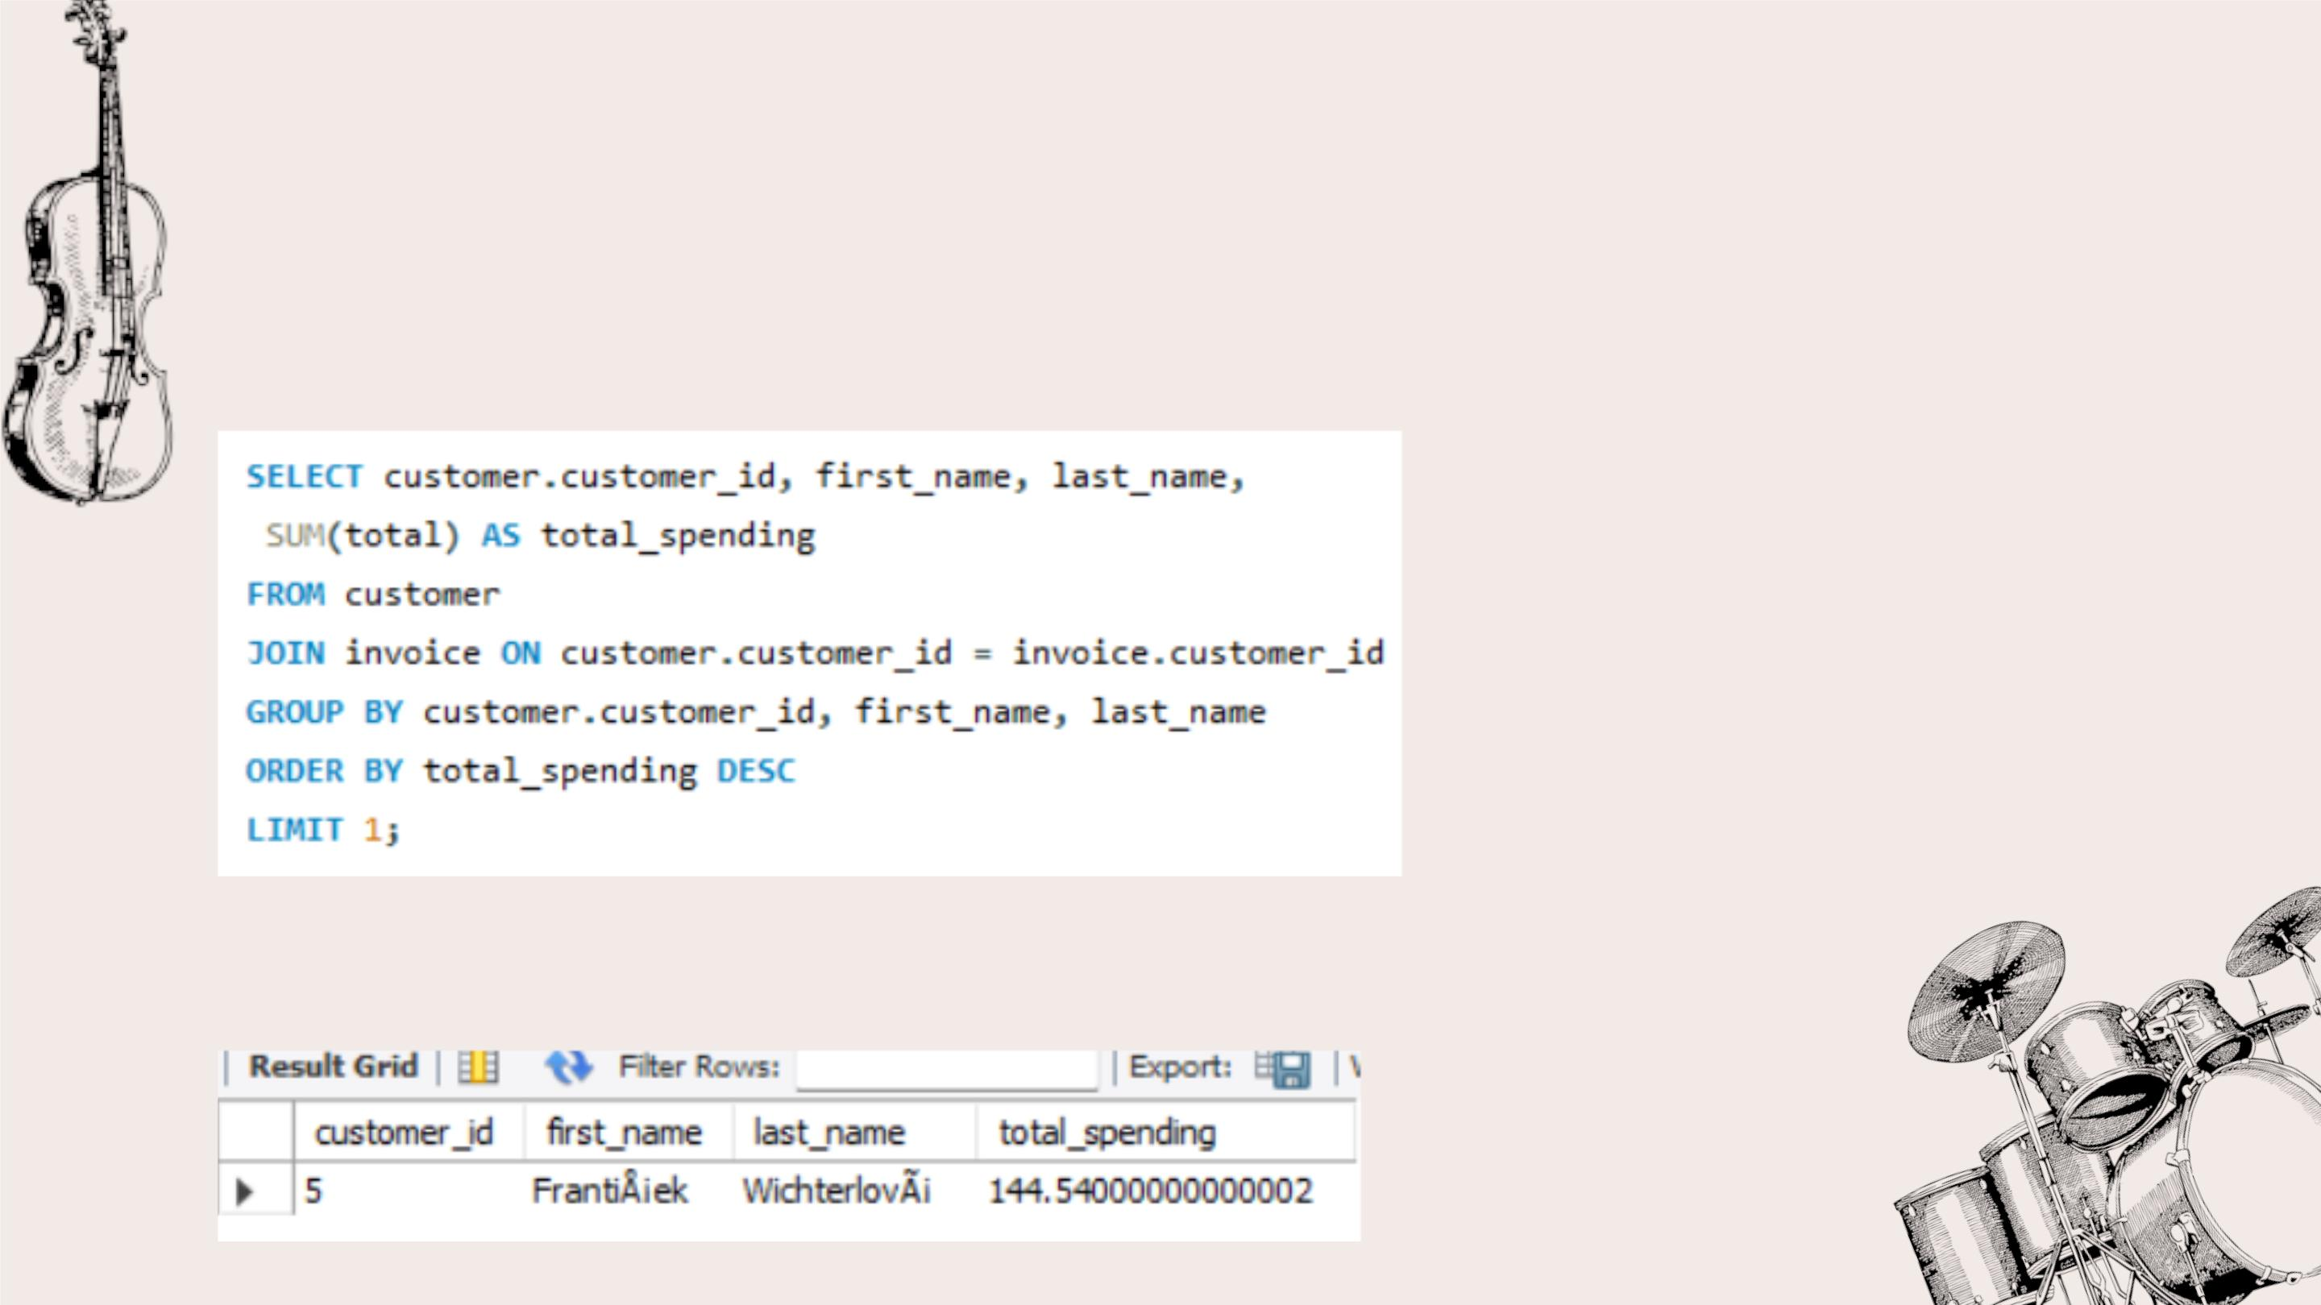
• Whoꢀisꢀtheꢀbestꢀcustomer?ꢀTheꢀcustomerꢀwhoꢀhasꢀspentꢀtheꢀmostꢀ
moneyꢀwillꢀbeꢀdeclaredꢀtheꢀbestꢀcustomer.Writeꢀaꢀqueryꢀthatꢀreturnsꢀ
theꢀpersonꢀwhoꢀhasꢀspentꢀtheꢀmostꢀmoney.
SQLꢀQUERY:
RESULT:

Slide 10

INTERMEDIATE

Slide 11
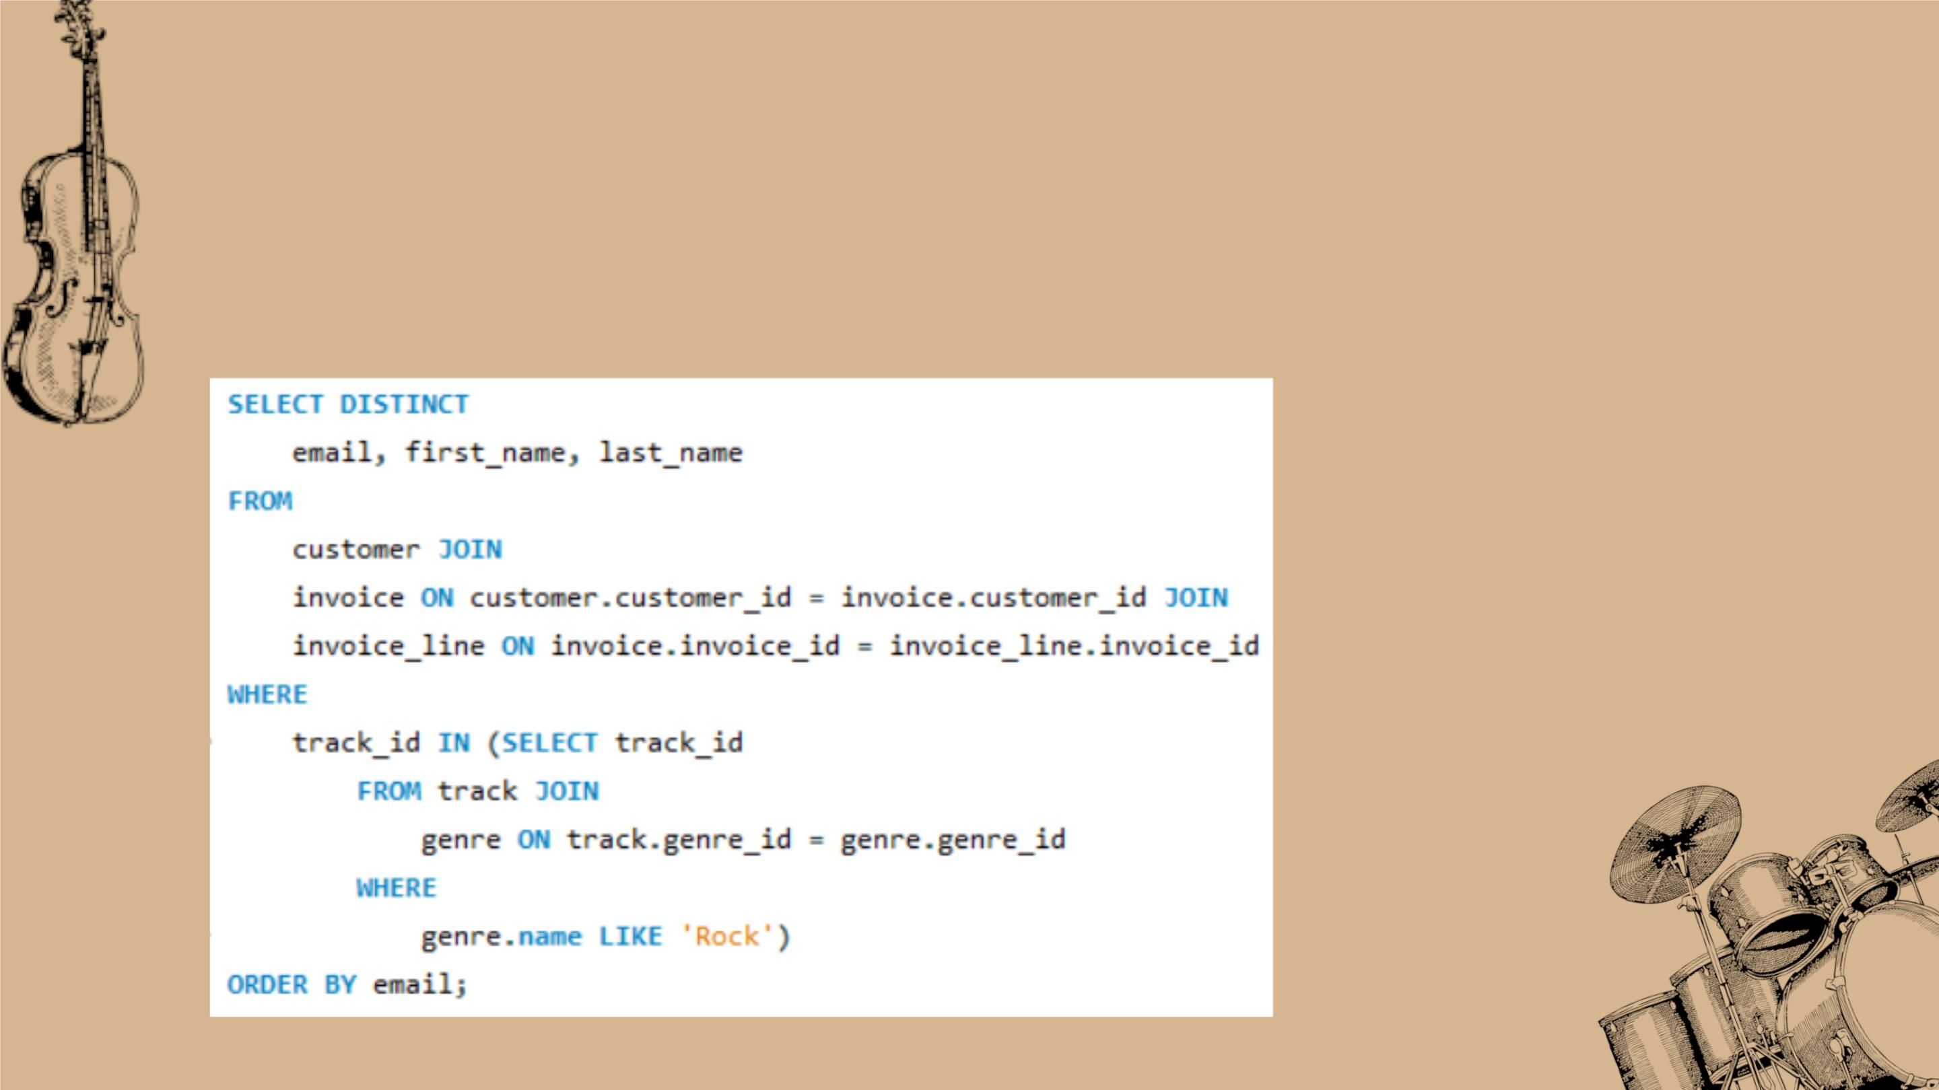
• ꢀWriteꢀqueryꢀtoꢀreturnꢀtheꢀemail,ꢀfirstꢀname,ꢀlastꢀname,ꢀ&ꢀ
GenreꢀofꢀallꢀRockꢀMusicꢀlisteners.ꢀReturnꢀyourꢀlistꢀorderedꢀ
alphabeticallyꢀbyꢀemailꢀstartingꢀwithꢀA.
SQLꢀQUERY:

Slide 12
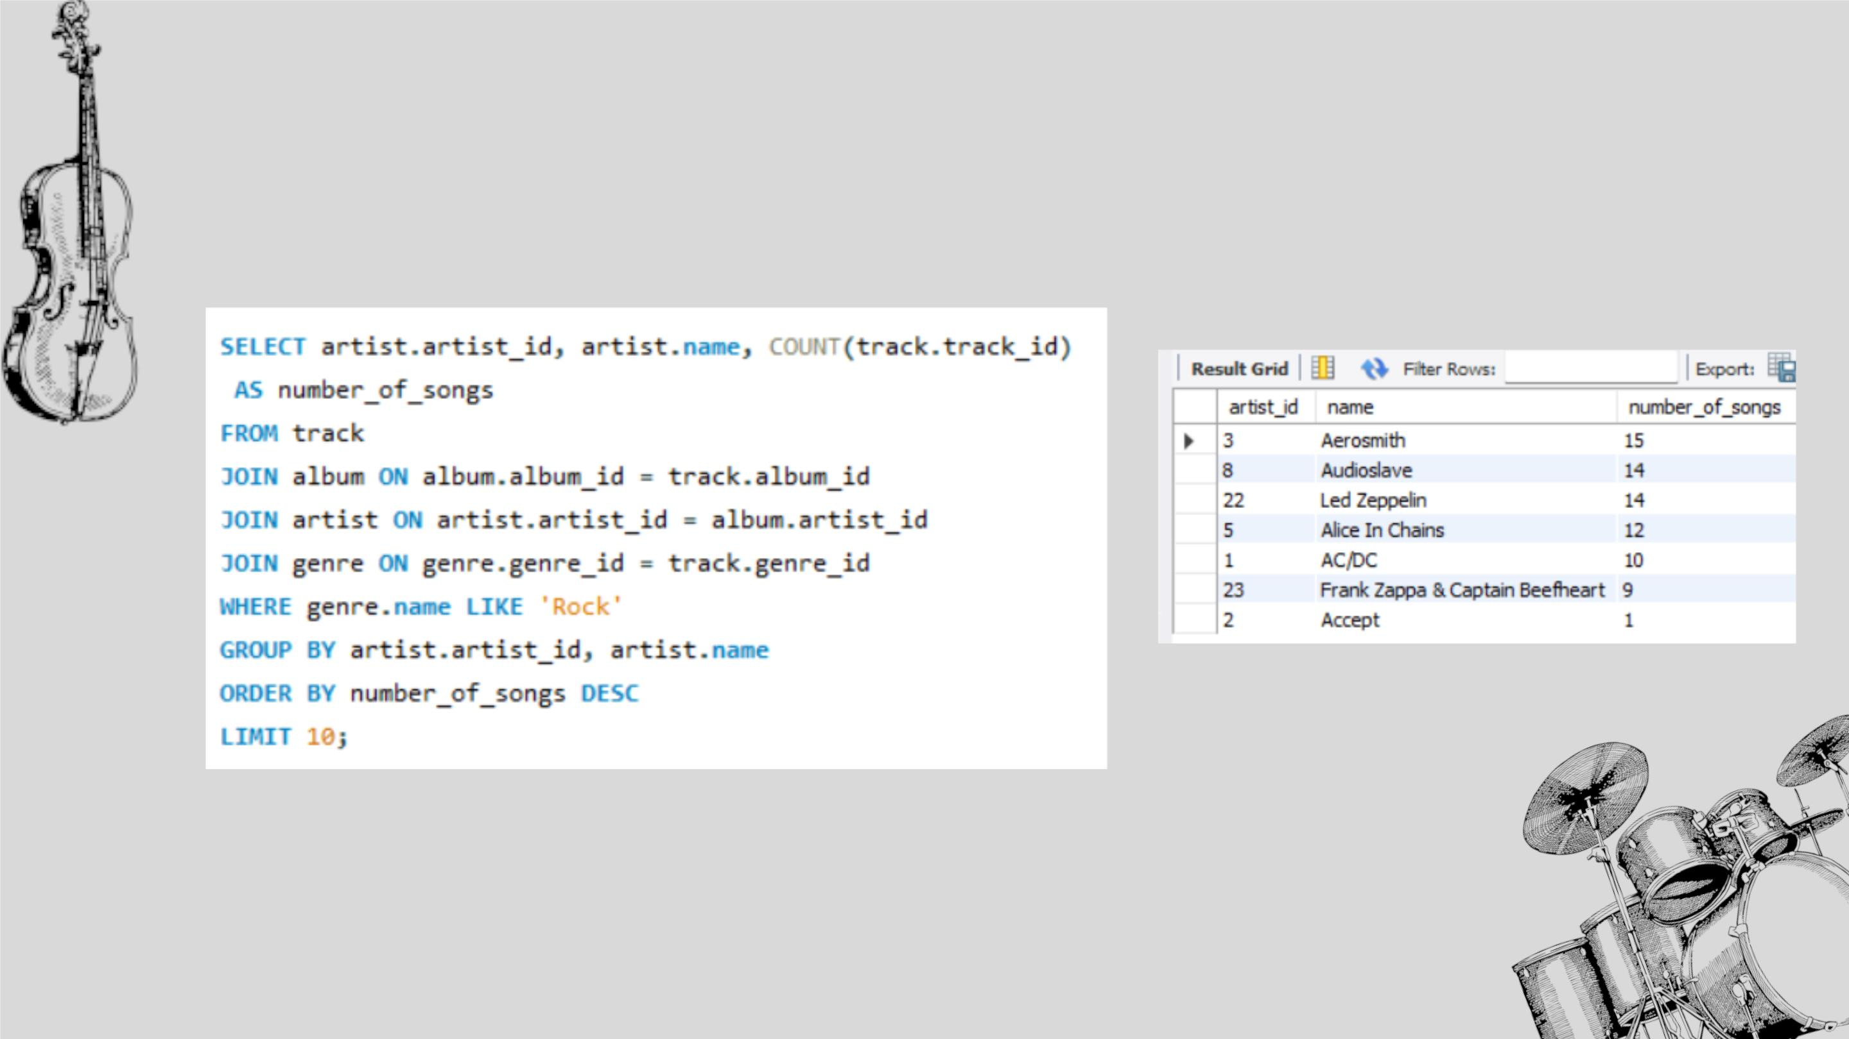
• ꢀLet'sꢀinviteꢀtheꢀartistsꢀwhoꢀhaveꢀwrittenꢀtheꢀmostꢀrockꢀmusicꢀinꢀ
ourꢀdataset.ꢀWriteꢀaꢀqueryꢀthatꢀreturnsꢀtheꢀArtistꢀnameꢀandꢀtotalꢀ
trackꢀcountꢀofꢀtheꢀtopꢀ10ꢀrockꢀbands.
SQLꢀQUERY:
RESULT:

Slide 13
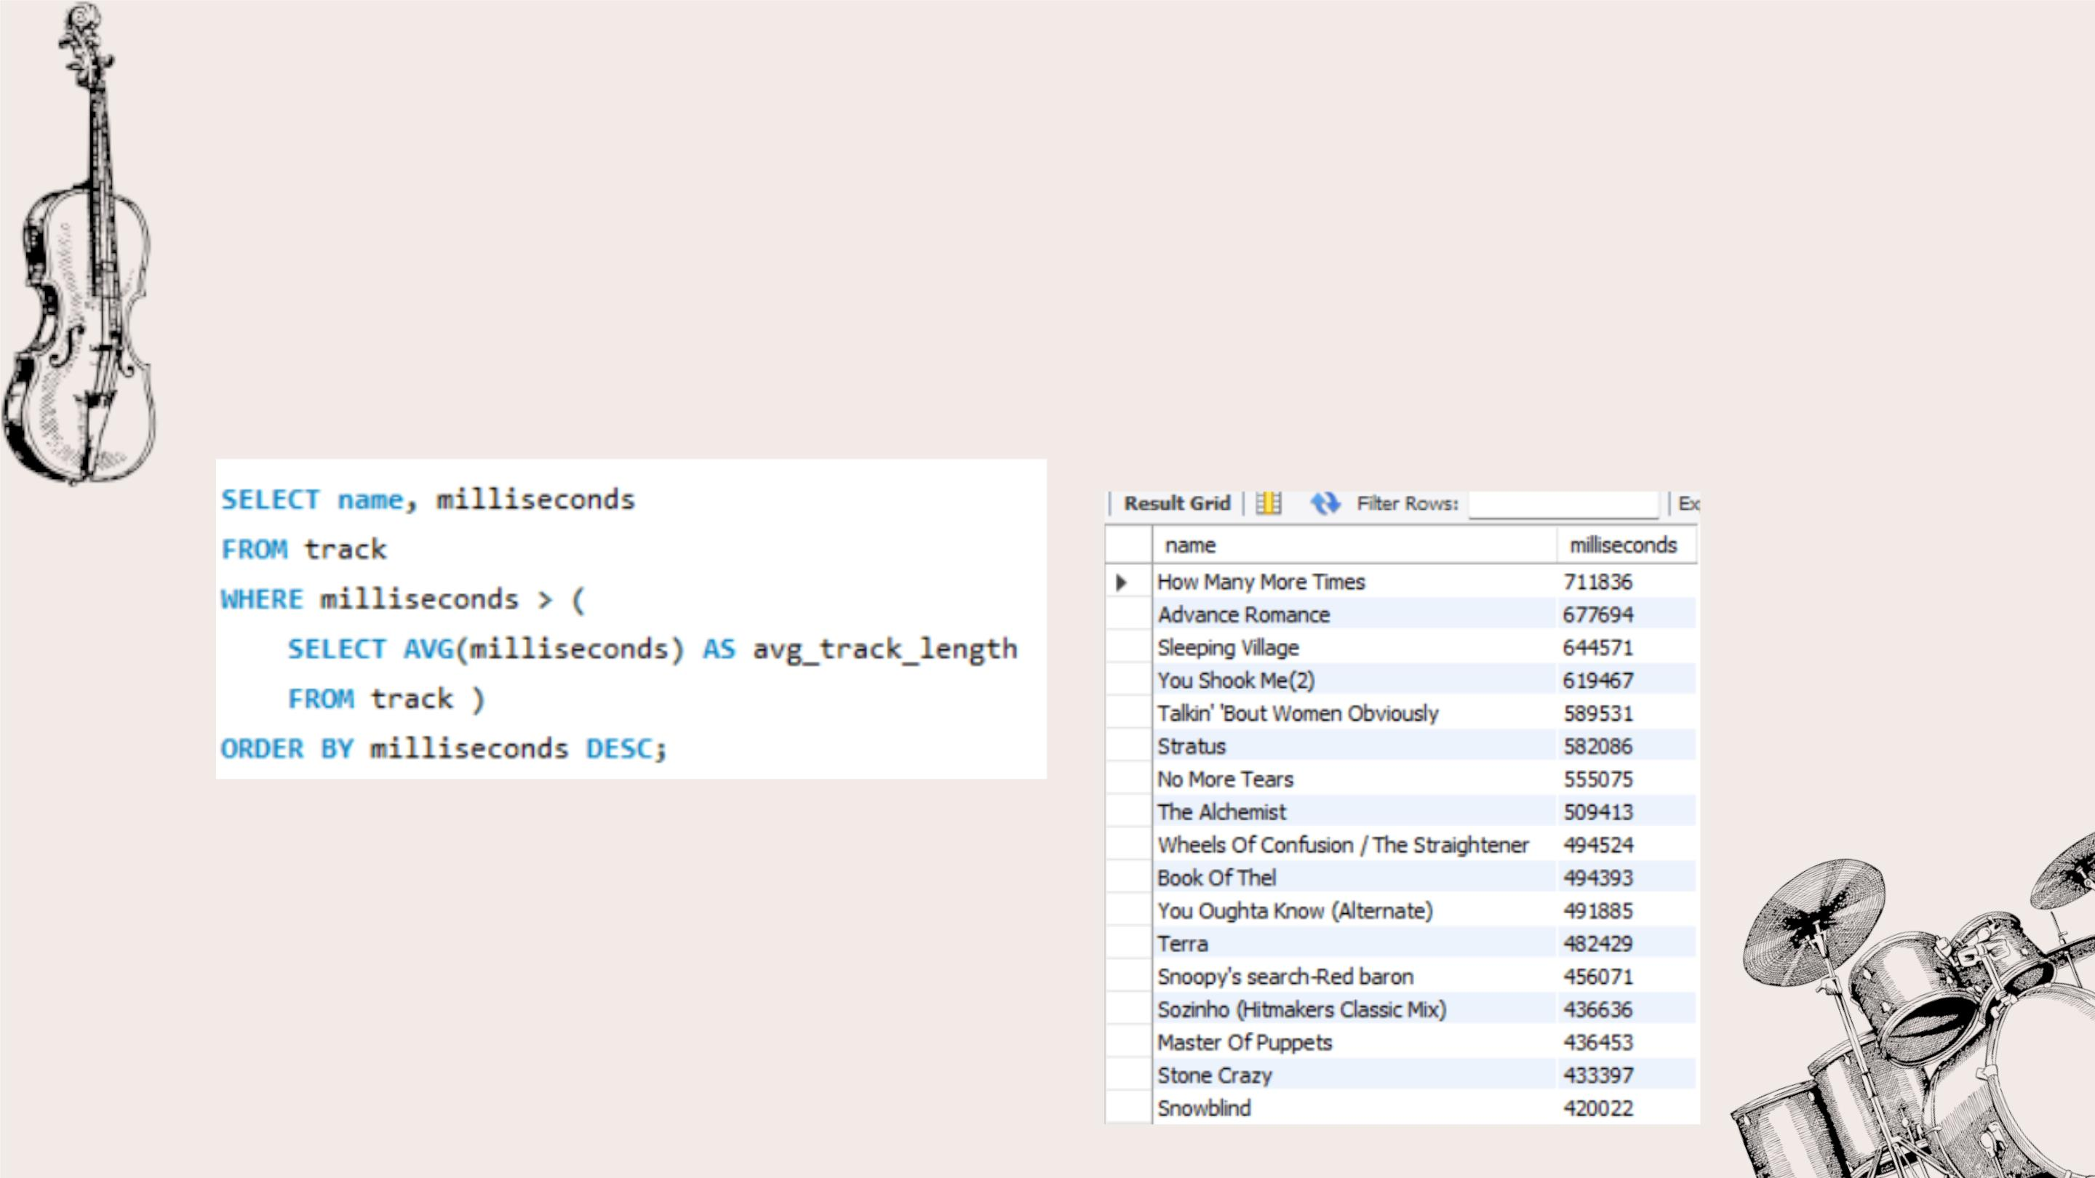
• Returnꢀallꢀtheꢀtrackꢀnamesꢀthatꢀhaveꢀaꢀsongꢀlengthꢀlongerꢀthanꢀ
theꢀaverageꢀsongꢀlength.ꢀReturnꢀtheꢀNameꢀandꢀMillisecondsꢀforꢀ
eachꢀtrack.ꢀOrderꢀbyꢀtheꢀsongꢀlengthꢀwithꢀtheꢀlongestꢀsongsꢀ
listedꢀfirst.ꢀ
SQLꢀQUERY:
RESULT:

Slide 14

AADDVVAANNCCEEDD

Slide 15
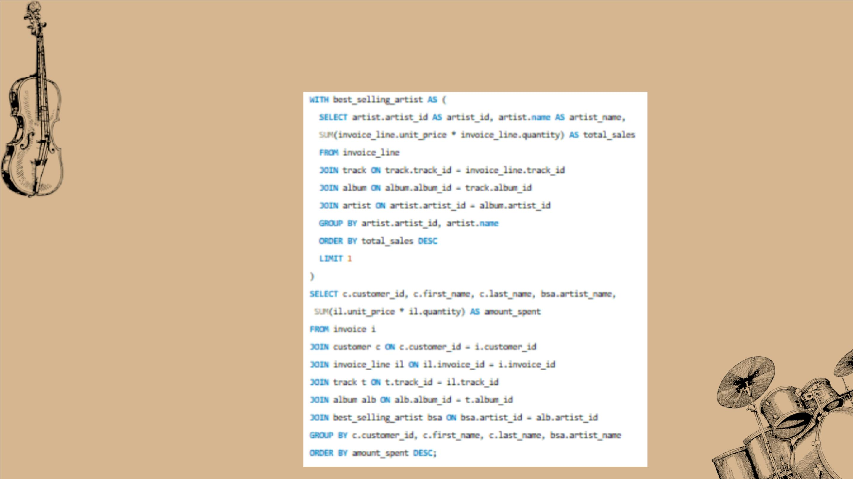
• ꢀFindꢀhowꢀmuchꢀamountꢀspentꢀbyꢀeachꢀcustomerꢀonꢀartists?ꢀ
Writeꢀaꢀqueryꢀtoꢀreturnꢀcustomerꢀname,ꢀartistꢀnameꢀandꢀtotalꢀ
spentꢀ
SQLꢀQUERY:

Slide 16
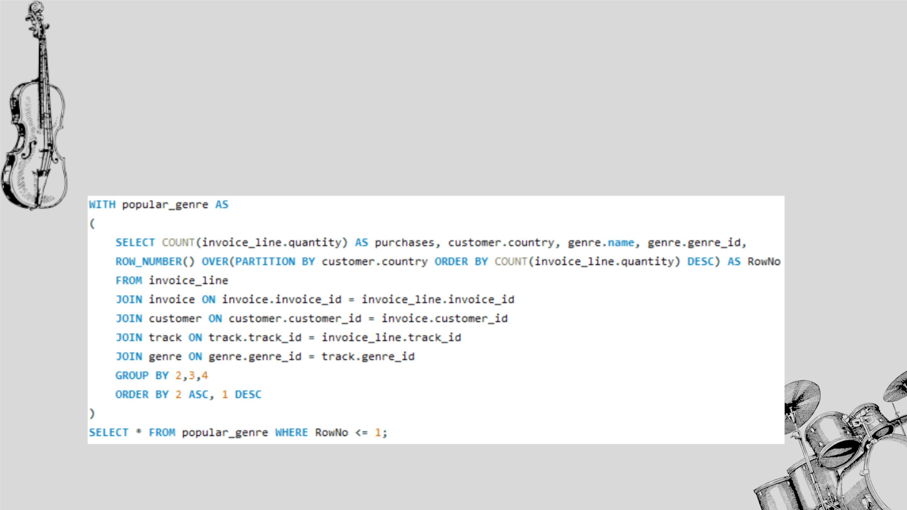
• ꢀWeꢀwantꢀtoꢀfindꢀoutꢀtheꢀmostꢀpopularꢀmusicꢀGenreꢀforꢀeachꢀcountry.ꢀWeꢀ
determineꢀtheꢀmostꢀpopularꢀgenreꢀasꢀtheꢀgenreꢀwithꢀtheꢀhighestꢀamountꢀofꢀ
purchases.ꢀWriteꢀaꢀqueryꢀthatꢀreturnsꢀeachꢀcountryꢀalongꢀwithꢀtheꢀtopꢀGenre.ꢀ
Forꢀcountriesꢀwhereꢀtheꢀmaximumꢀnumberꢀofꢀpurchasesꢀisꢀsharedꢀreturnꢀallꢀ
Genres.
SQLꢀQUERY:

Slide 17
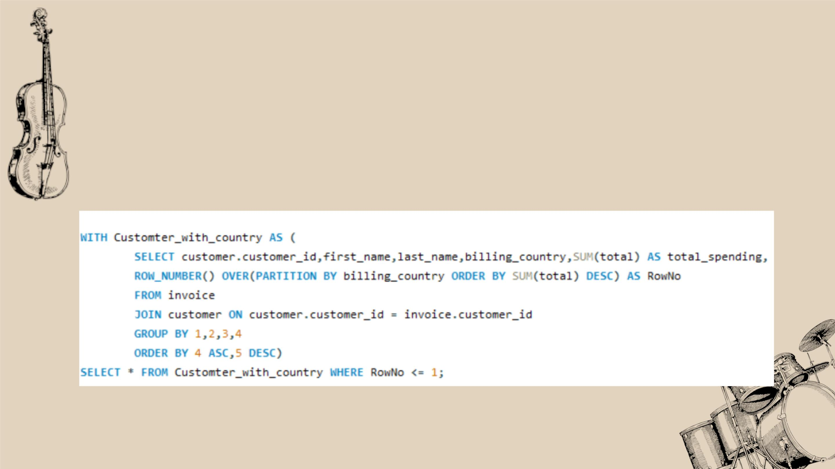
• ꢀWriteꢀaꢀqueryꢀthatꢀdeterminesꢀtheꢀcustomerꢀthatꢀhasꢀspentꢀtheꢀmostꢀonꢀ
musicꢀforꢀeachꢀcountry.ꢀWriteꢀaꢀqueryꢀthatꢀreturnsꢀtheꢀcountryꢀalongꢀwithꢀ
theꢀtopꢀcustomerꢀandꢀhowꢀmuchꢀtheyꢀspent.ꢀForꢀcountriesꢀwhereꢀtheꢀtopꢀ
amountꢀspentꢀisꢀshared,ꢀprovideꢀallꢀcustomersꢀwhoꢀspentꢀthisꢀamount.
SQLꢀQUERY:

Slide 18

• Softwareꢀusedꢀ:ꢀꢀ
MySql
• Language:Sql

